Slide 1
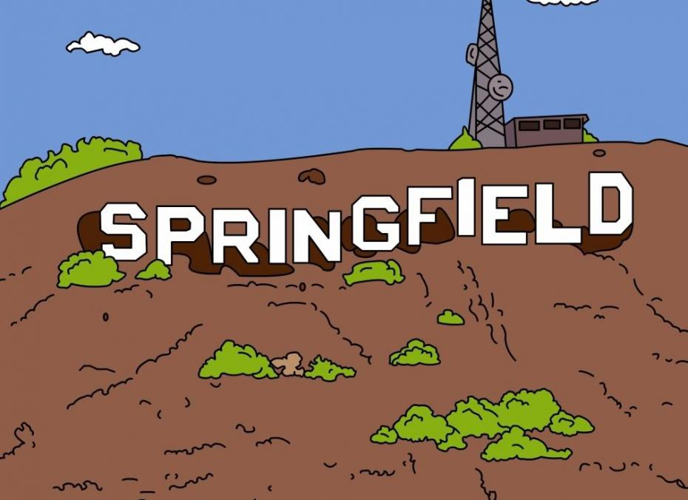
I love rock n roll

Slide 2
I saw him dancin there by the record machine

Slide 3
The beat was goin strong

Slide 4
Playin my favorite song

Slide 5
An I could tell it wouldnt be long

Slide 6
Till he was with me, yeah me, singin

Slide 7
He smiled so I got up and asked for his name

Slide 8
That dont matter, he said,

Slide 9
An next we were movin on

Slide 10
He was with me, yeah me

