Slide 1
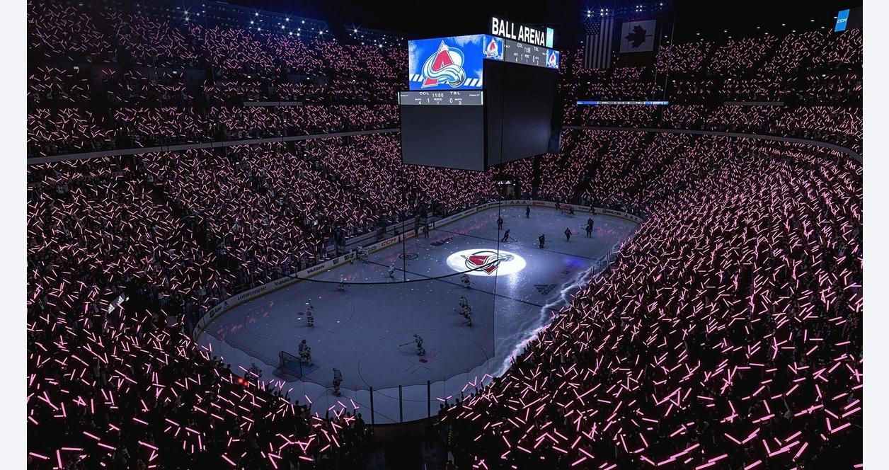
NHL 23
By Félix Poulin

Slide 2
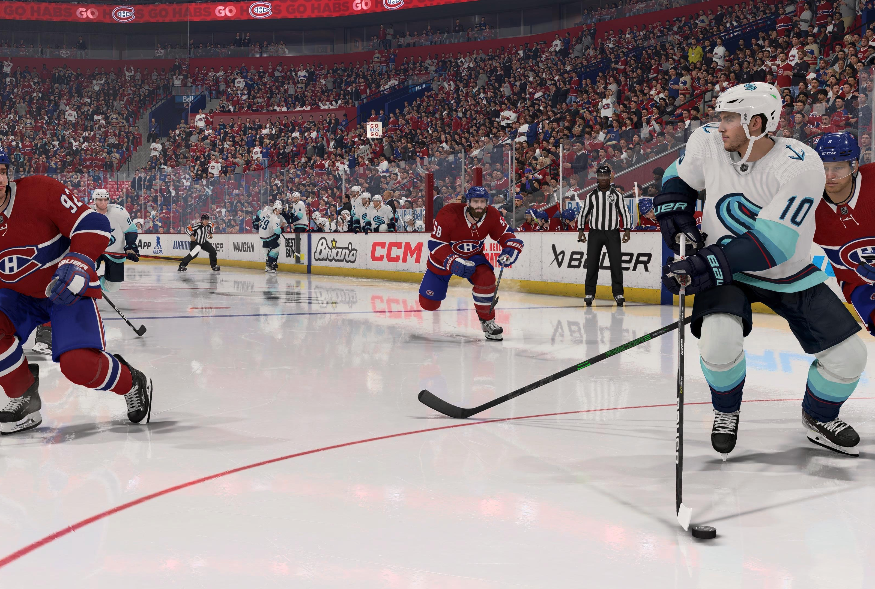
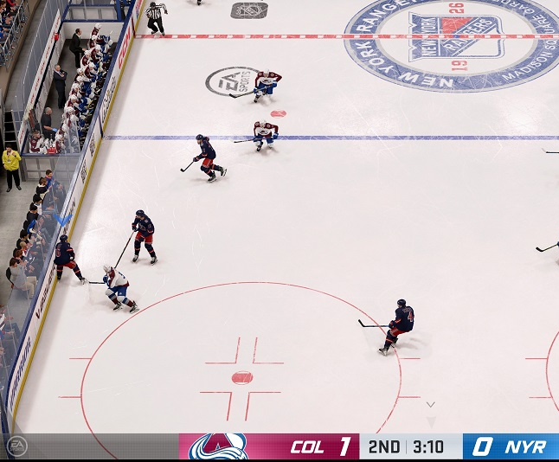
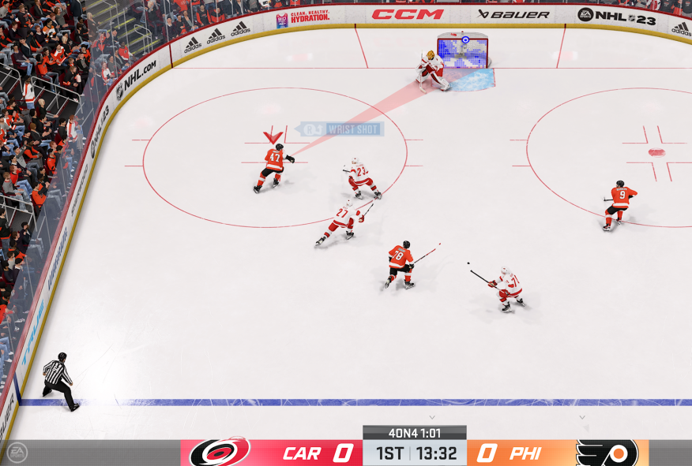
The goal of the game is to do alot of goal and after 3 periode the teams as goal more goal won the game

