Slide 1
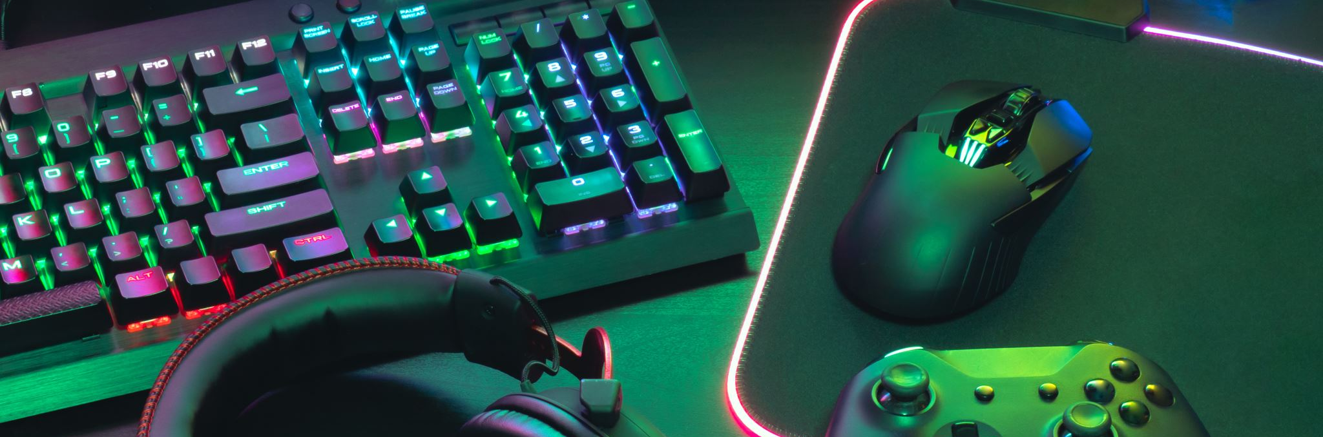
Gaming by Émile Poulin

Slide 2
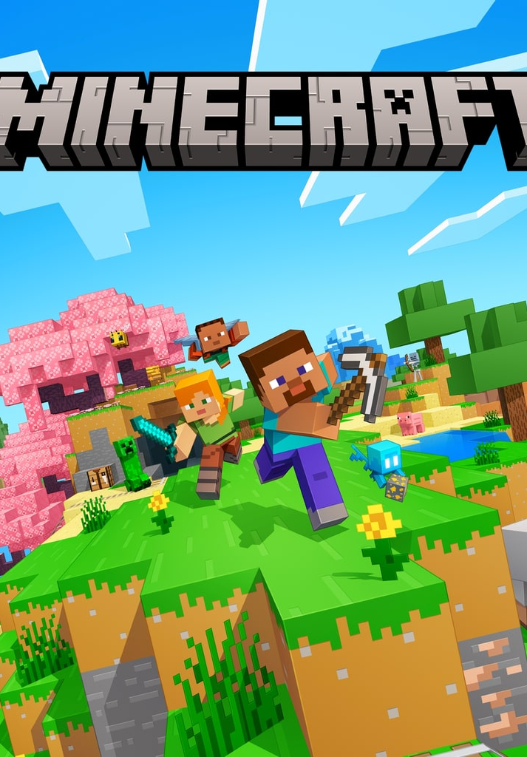
The game
Minecraft is a very cool game. The mission of the game is to survive (in survival mod) or to create (in creative mod)
another mission in survival is to beat the ender dragon, the final boss of the game
crafting
Table
The crafting table is the most important object in all the game. You must use this block to finish the game. without this block, you couldn't make any armor, pickaxes or furnace. Crafting table is very, VERY essential for a survival game.
mobs
there are a lot of mobs, in minecraft there are peaceful mobs (like pigs, cows, etc.) and hostile mobs (like creepers, zombies, skeletons…). If you don't want hostile mobs in your survival or creative game, you should put your game in mod «peaceful».

Slide 3
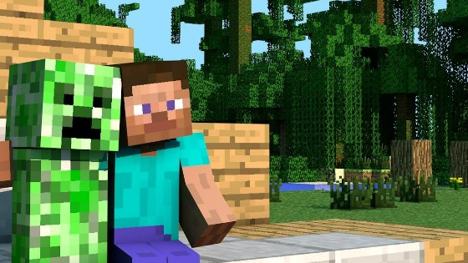
The game
Minerals
A lot of minerals exist in minecraft.with themes,you can craft pickaxes, axes, armors, etc.
structures
Minecraft is a game that contains a lot of structures. There are little structures like the treasure chest (it counts like a structure) or big structures like the ancient city.(in this place, you could find the warden.) The village is an important structure, because it's the only place that you can find villagers (to trade with them). the pyramid, the village, the ancient city, the pillagers

Slide 4
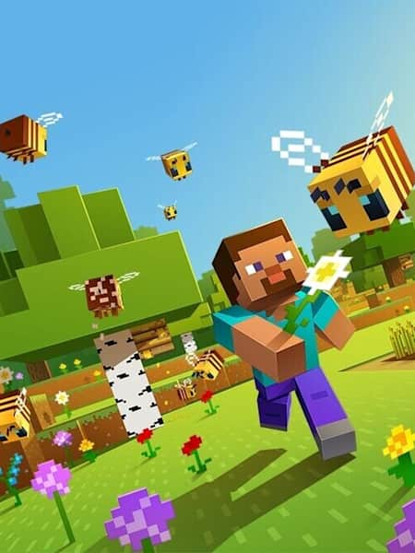
game
tower, the mansion… I can’t talk about all of them, because it's going to be too long.
Dimensions are important in minecraft. without themes you will not be able to finish the game. There is the Nether and the End. The nether is like hell; the majority of the dimension is in dark red.The End is a place that you will see the ender dragon and a lot of endermans.
conclusion: I find Minecraft very interesting, because it’s an old game that doesn't continue to get better and better in all updates. As far as I’m concerned, Minecraft is one of my favorite games. You should try it!

Slide 5
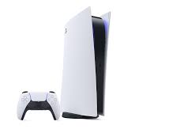
The console
The console that I use to play minecraft Is a PS5 (playstation 5). This console look like this

