Slide 1
Gaming
By Andreï Marcoux

Slide 2
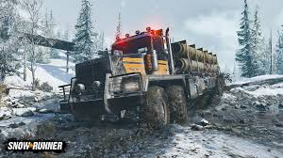
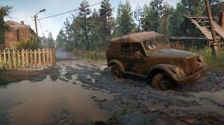
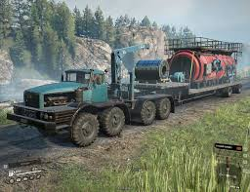
Snow runner
On playstation
You are driving a truck on mud, snow and water

