Slide 1
Gaming
By Marilie maheu

Slide 2
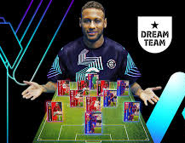
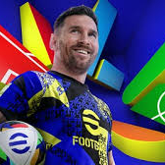
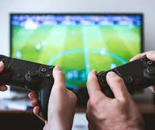
eFootball
Soccer game
You can play with friend
Thers 2 kind of matchs. The autentics and the dream game.
With Xbox

