Slide 1
Gaming
By Félix Lachance

Slide 2
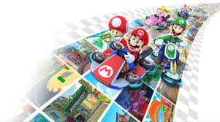
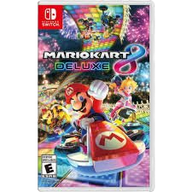
Mario kart is in nintendo switch

Slide 3
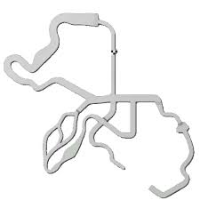
The goal of the game ?
The goal of the game is to finish first in a three lap kart races

