Slide 1
Gaming
By zack labbé

Slide 2
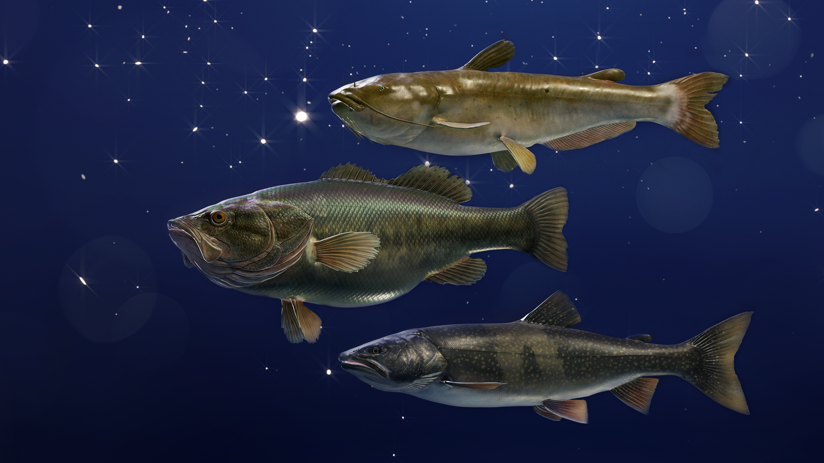
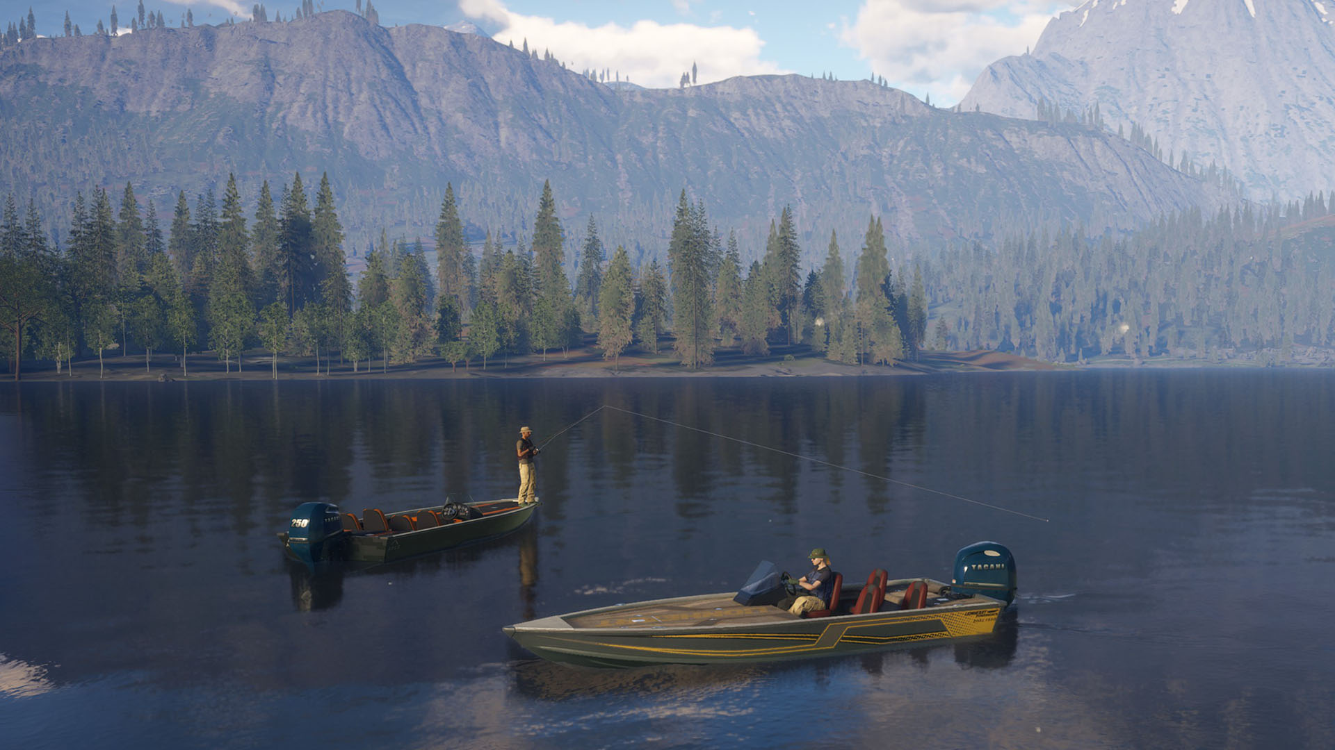

The angler, ps4-ps5, xbox, open world fishing game

