Slide 1
Gaming
By Pier-Alexandre

Slide 2
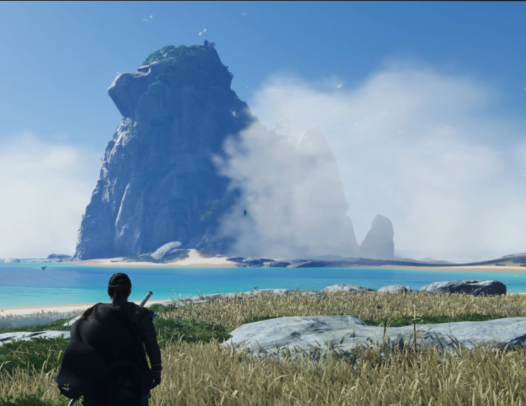
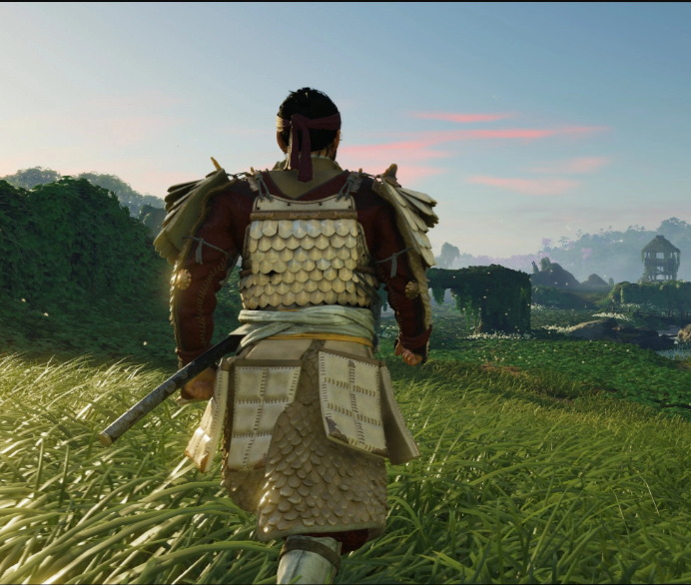
Ghost of Stushima
PS5
The goal of the game is to save your uncle from the mongol king

