Slide 1
Gaming
By Jacob

Slide 2
Brawl star
its a mobil game.

Slide 3
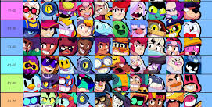
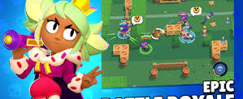
It’s a online game you can play with your friends.
In this game you have different
Mod and brawler rarity. Its combat.

