Slide 1
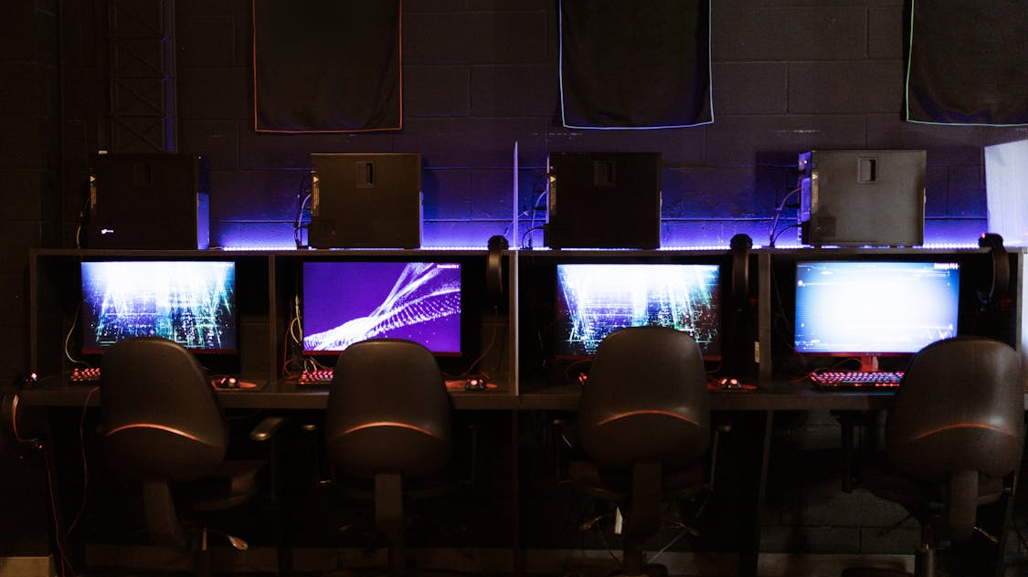
gaming
By maveryk-jutras-leroux

Slide 2
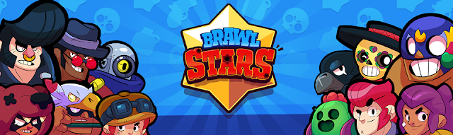
Brawl stars
You can only play this on a tablet or also on every phone

Slide 3
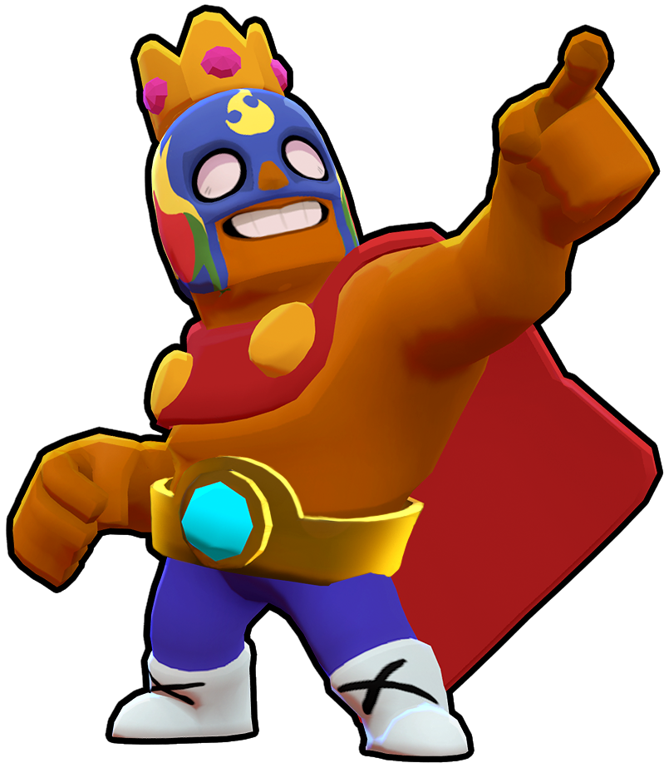
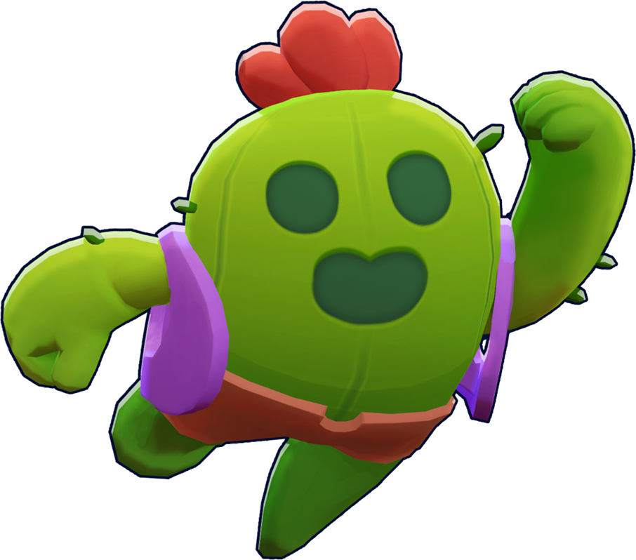
You can play mini games to kill people and in solo showdown when you kill them you get an amount of power cubes depending on how munch power cubes they have and when you win you get trophy but if you lose, you lose some and this is used so you get reward
ThePhoto by PhotoAuthor is licensed under CCYYSA.

