Slide 1
PASSION
By Lily-Rose Jacques

Slide 2
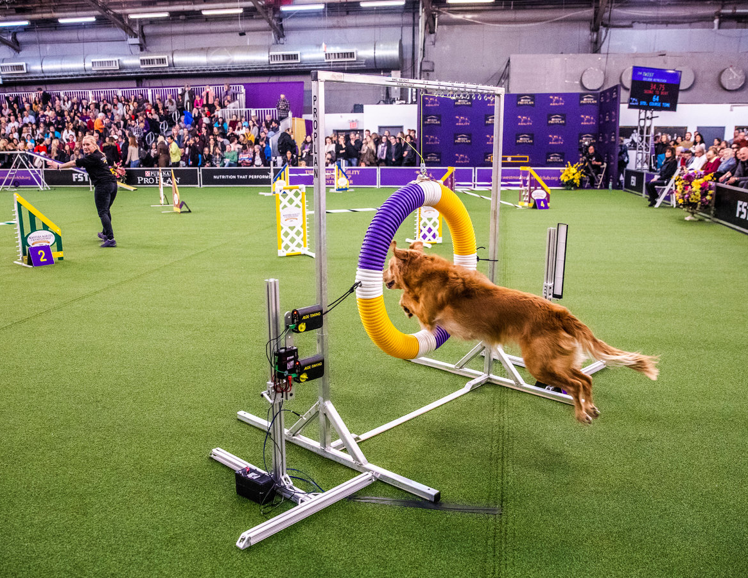
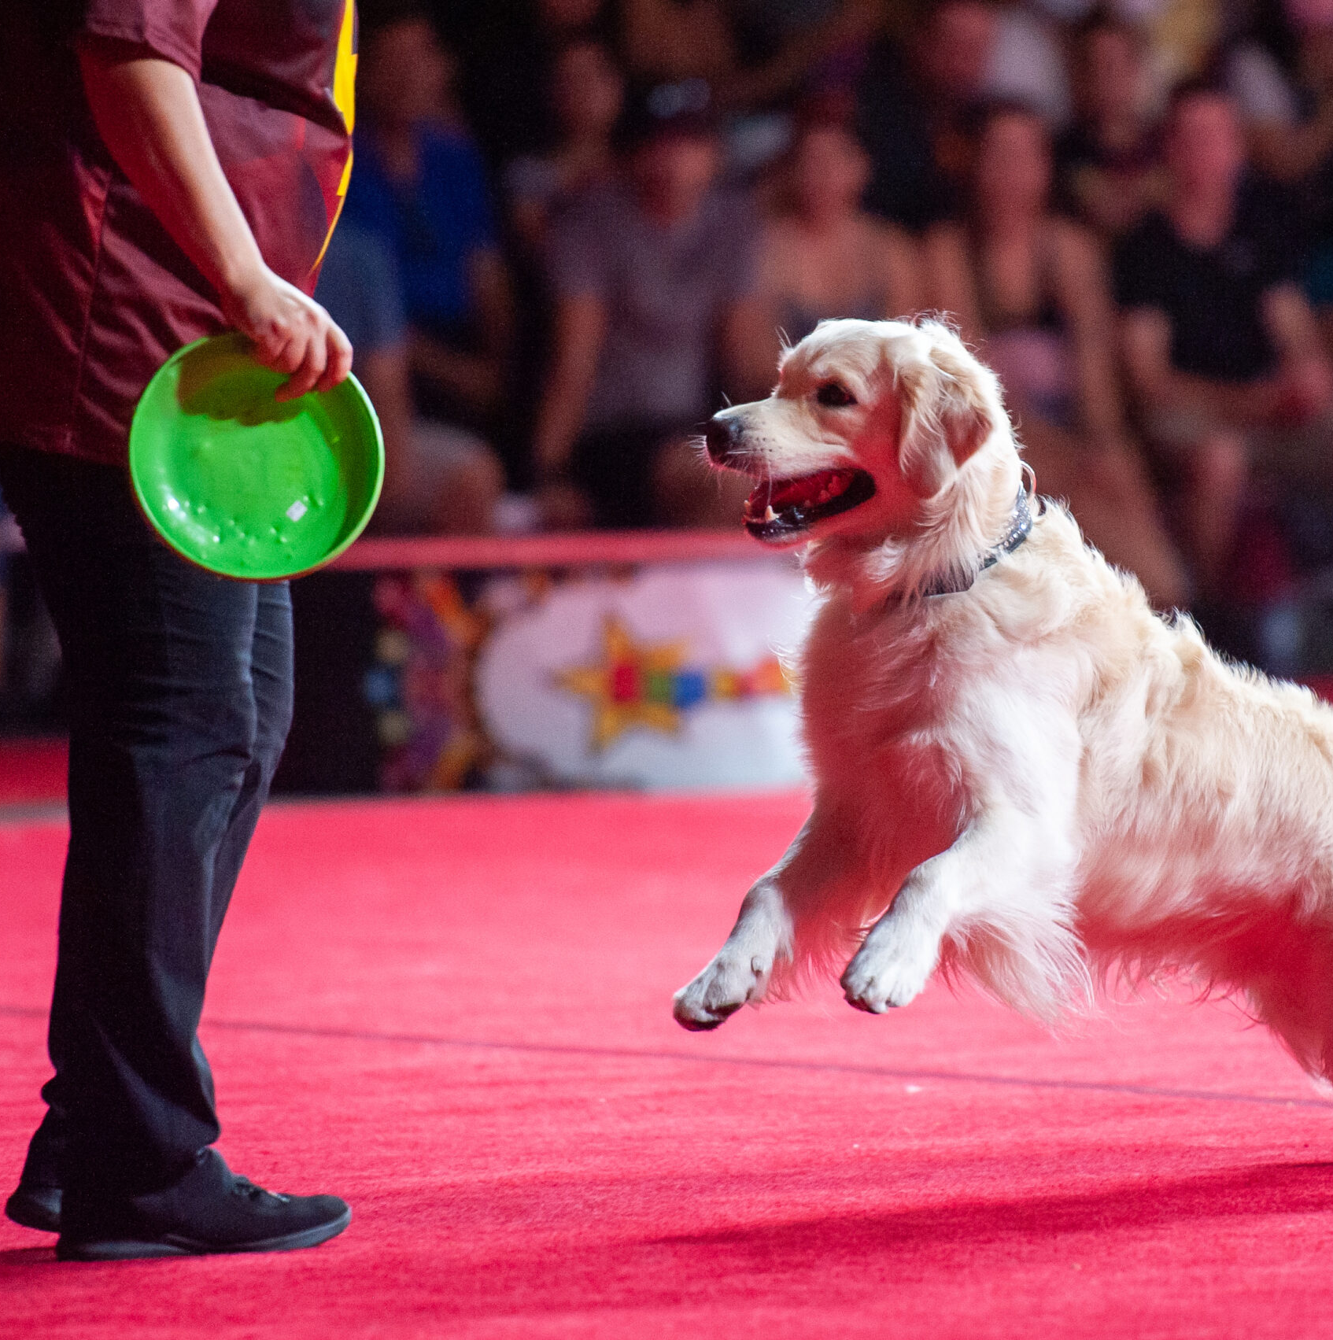
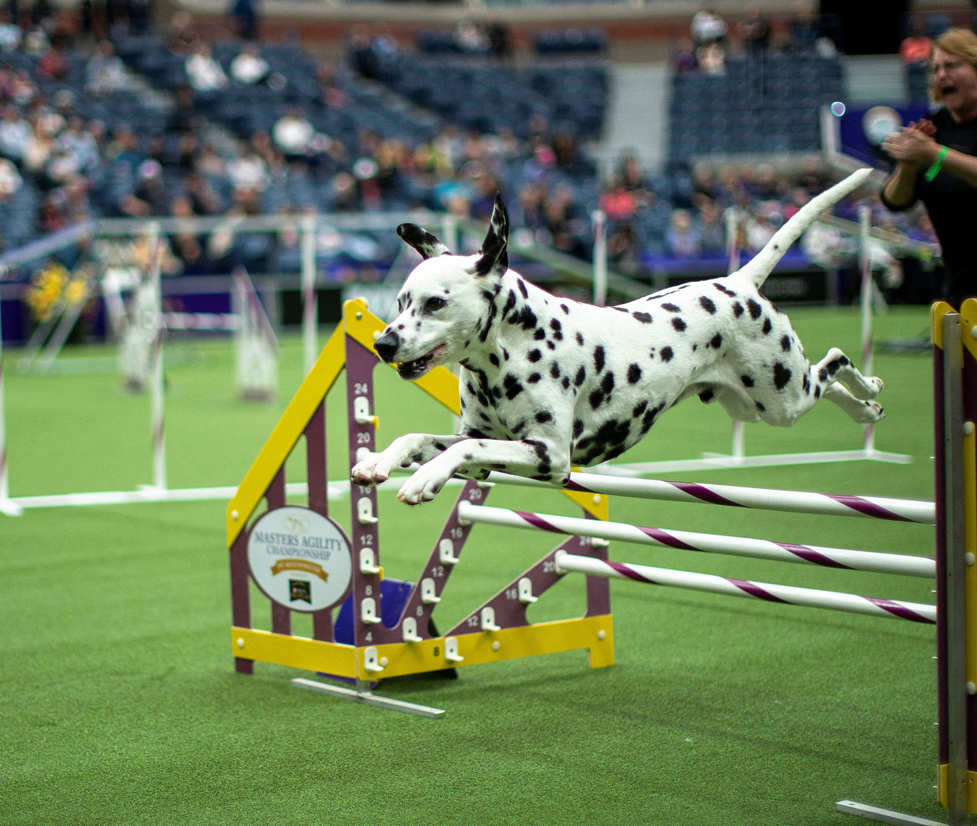
DOG SHOW
EXPLICTION
The goal of dog show is for the dogs to face the obstacle as quickly as possible

