Slide 1
Barrel racing
By Juliette Jacques

Slide 2
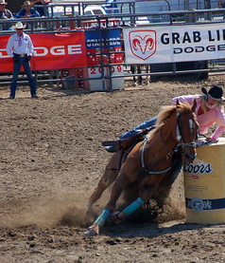
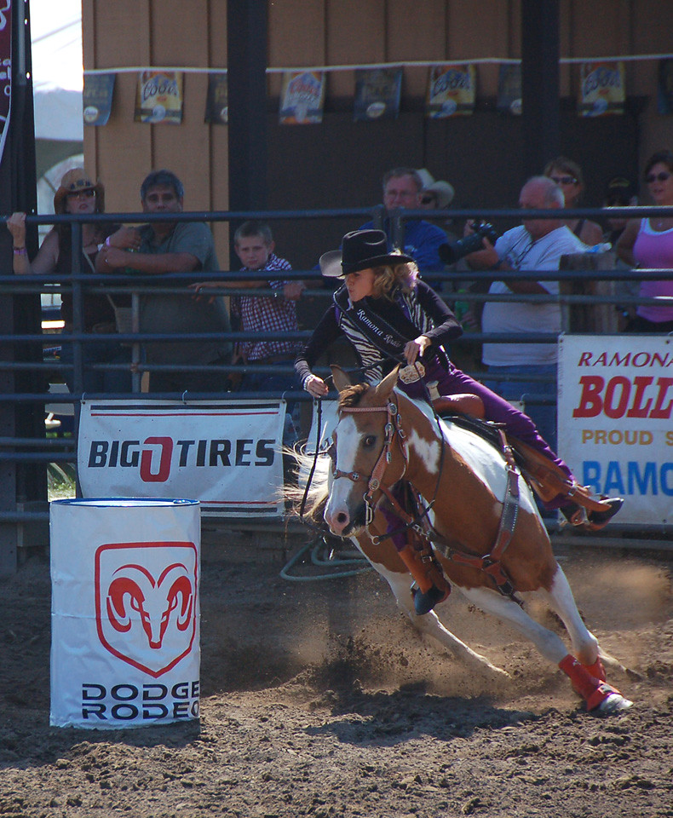
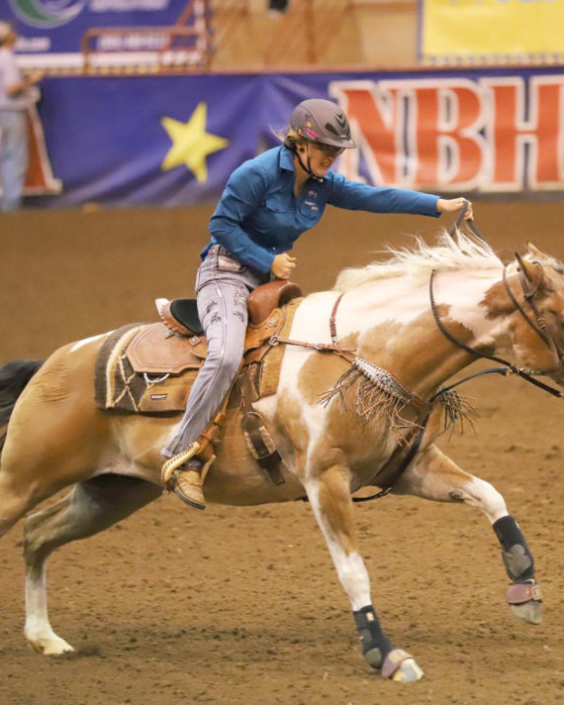
Barrel racing
FamilyID=Office_ArchiveTorn
You are on a horse and after you have to turn around three barrel and you have to finish very fast

