Slide 1
Passion (Drawing)
By Camélia Bouffard

Slide 2
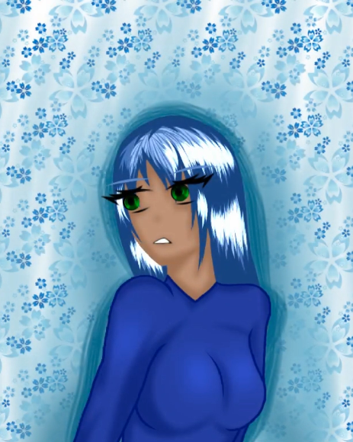
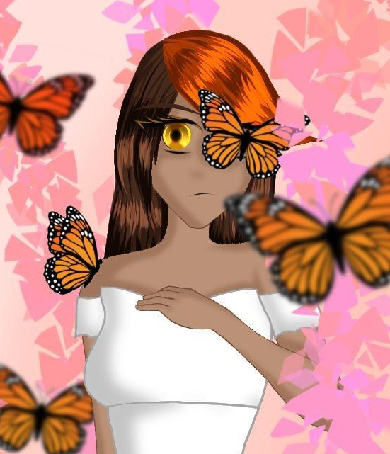
Painting, digital or with a pencil/pen

