Slide 1
Storyboard
Fait par Jérôme Cliche
MSI
2017-11-13

Slide 2
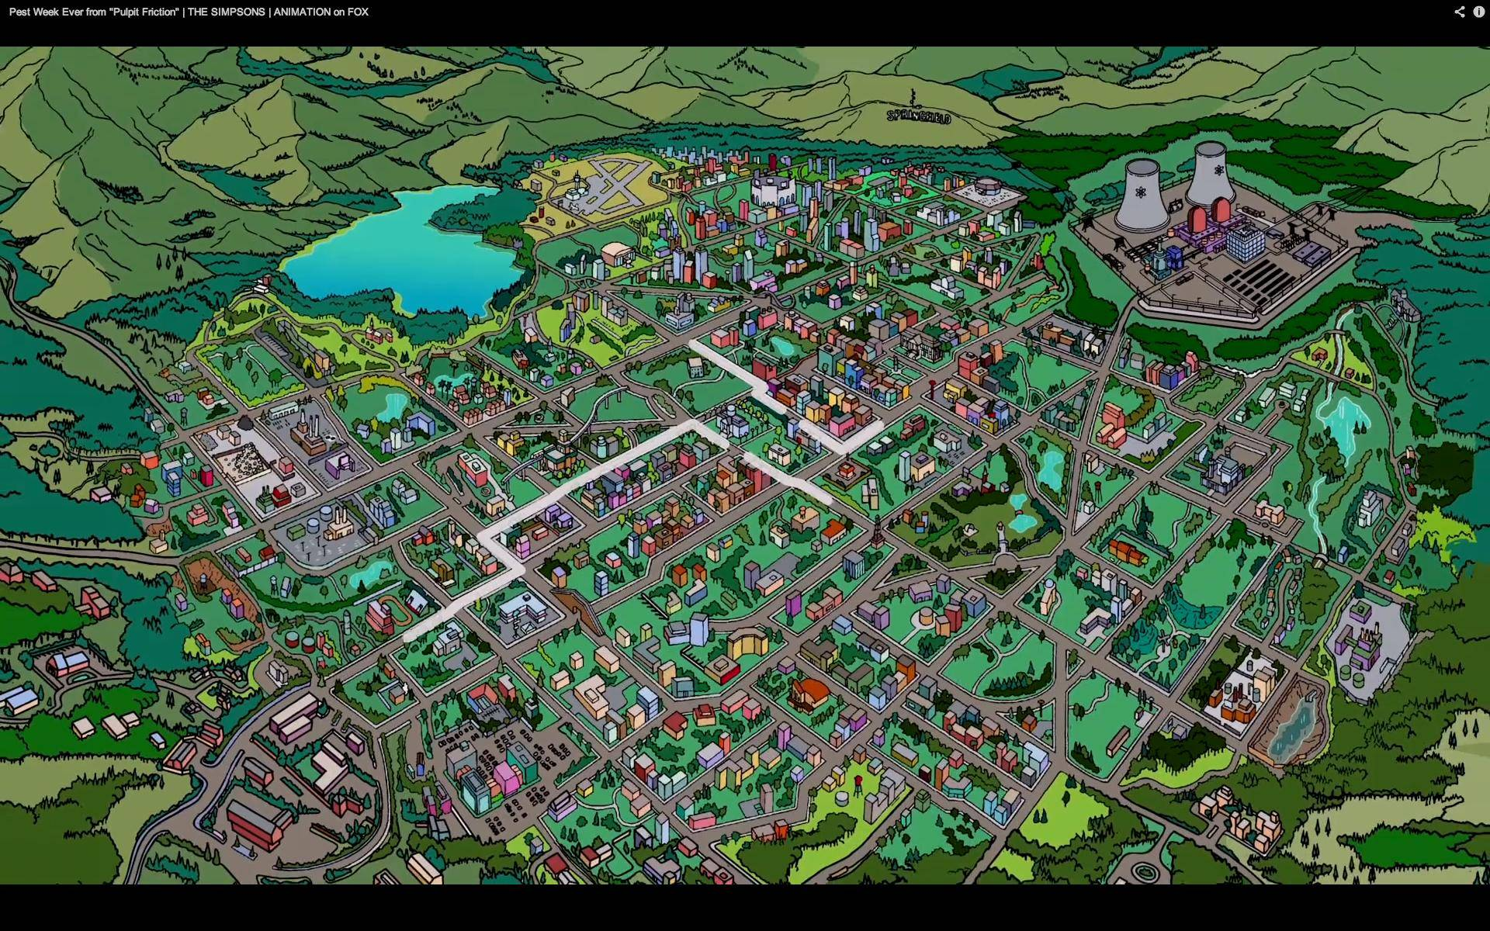
Looking in your eyes I see a paradise

Slide 3
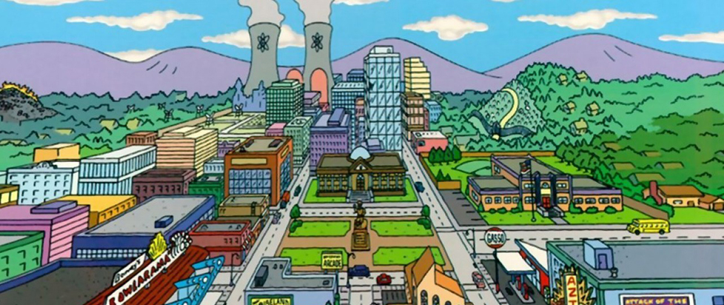
This world that Ive found

Slide 4
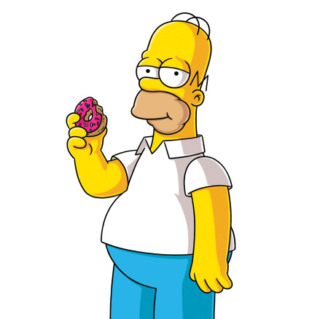
Is too good to be true

Slide 5
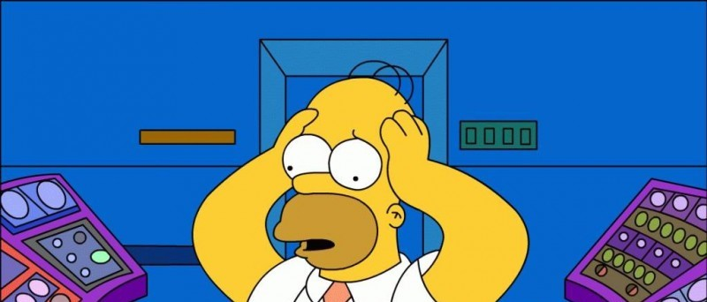
Nothings gonna stop us now

Slide 6

Standing strong forever

Slide 7
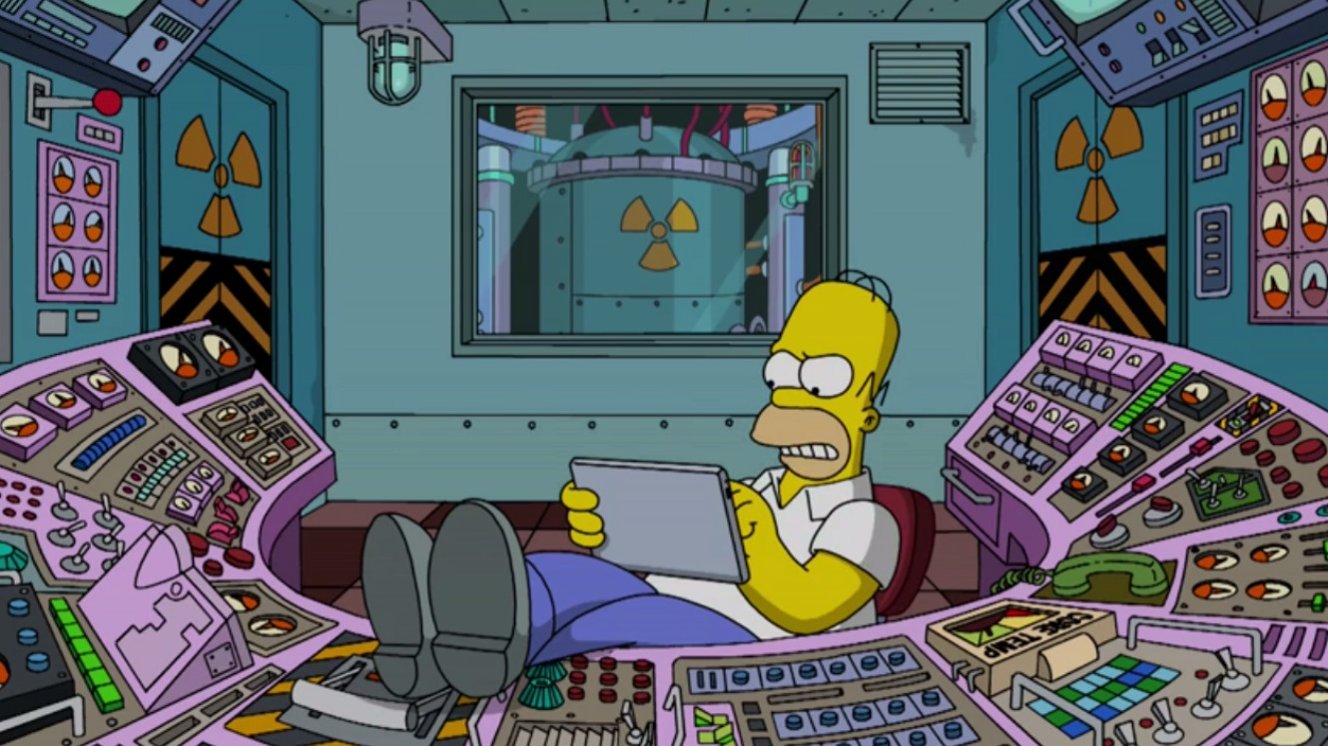
Dont ever let go

Slide 8
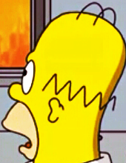
Ooh, all that I need is you

Slide 9
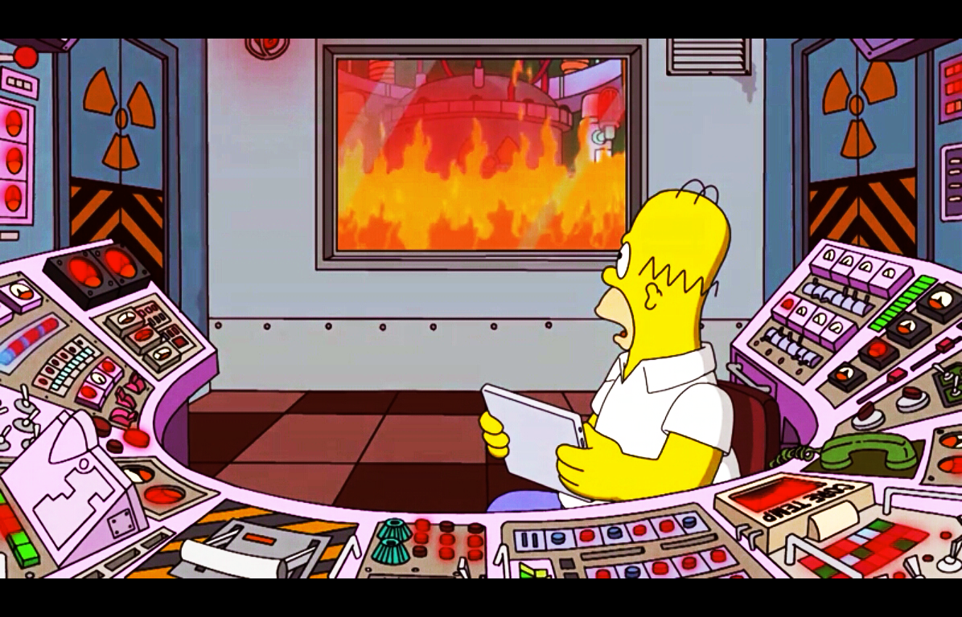
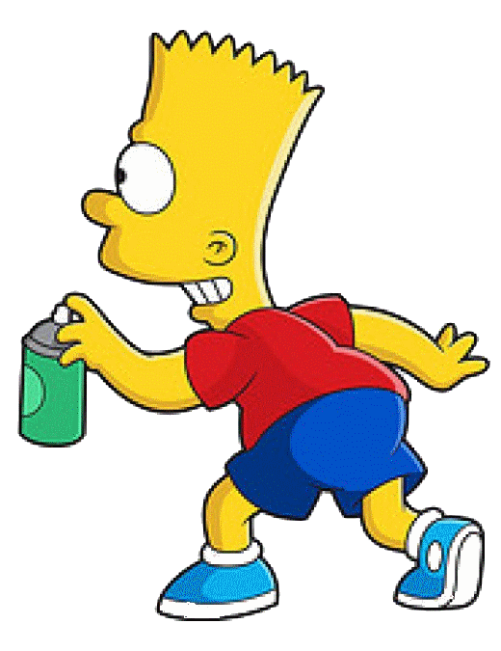
And we can build this dream together

Slide 10
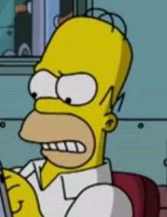
Im not gonna lose you

Slide 11
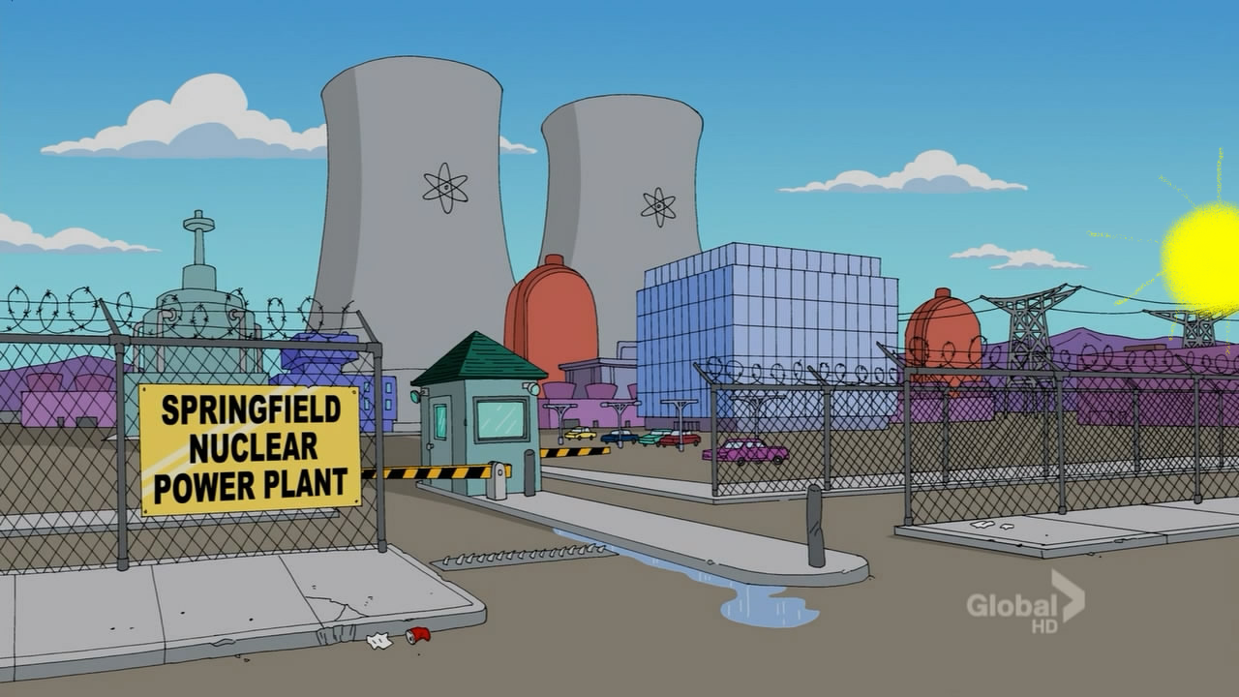
Let the world around us just fall apart

